Slide 1

Brazilian E-Commerce Public Dataset by Olist
Capstone Portfolio Project 1
01

Slide 2

About Group H, Capstone project 1
Cohort 5
Data Analytics
Institute of Emerging Careers (IEC)

Slide 3

Our Team Members
Ahmed
Shahroz
Irfana Perveen
Muhammad Nouman Akhtar
Shaiza Mann

Slide 4
Database Background
This is a Brazilian E-Commerce public dataset of orders made at “Olist Store”. The dataset has information on 100k orders from 2016 to 2018 made at multiple marketplaces in Brazil. Its features allow viewing orders from various dimensions: from order status, price, payment, and freight performance to customer location, product attributes, and finally reviews written by customers. We also released a geolocation dataset that relates Brazilian zip codes to LAT/LNG coordinates.
https://www.kaggle.com/datasets/olistbr/brazilian-ecommerce

Slide 5

Database Schema

Slide 6
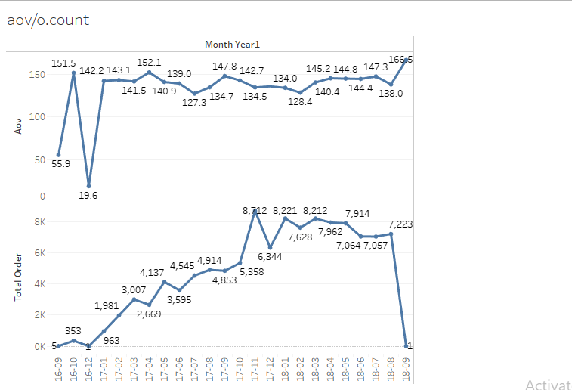
AVERAGE ORDER COUNT/ ORDER COUNT:

Slide 7
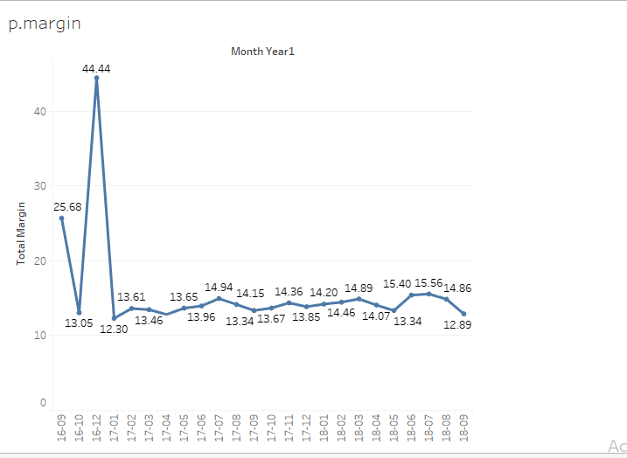
Find net profit margins:

Slide 8
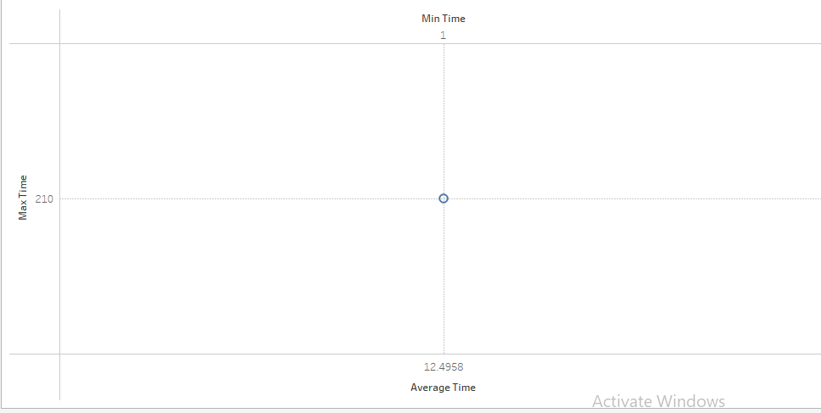
Find average delivery time:

Slide 9
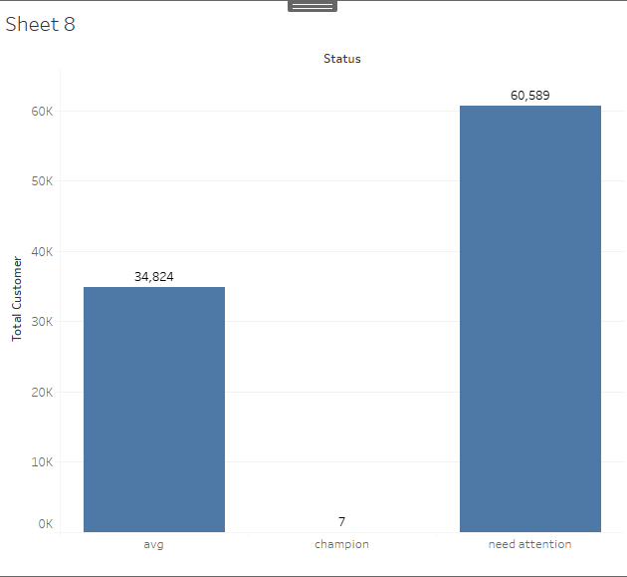
Conduct RFM analysis for this dataset:
champion:
rfm_recency >4, rfm_monetary >4 and rfm_frequency =2
Average:
rfm_recency > 2, rfm_monetary > 2 and rfm_frequency = 1

Slide 10
SUMMARY AND RECOMMENDATION:
Summary:
Business is struggling with the frequency of the customer and Average order value.
Recommendation:
Data should include the Name and E-mail address in the customer’s table to better reach customers for sales promotion and other marketing campaigns.
And add the cost price per item in the order’s item table for better analysis of cost relating matrices.
Should design a marketing campaign and sales promotions separately according to the need of each segment of the customer.
Should work on the cost-cutting strategy for a better grip on the revenue and to give free shipping to the champions and average segment of the customer

Slide 11
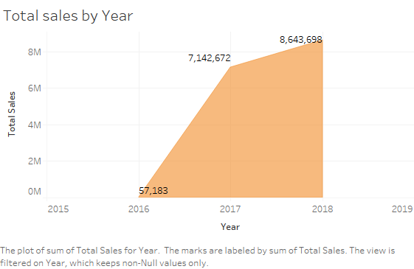

Slide 12
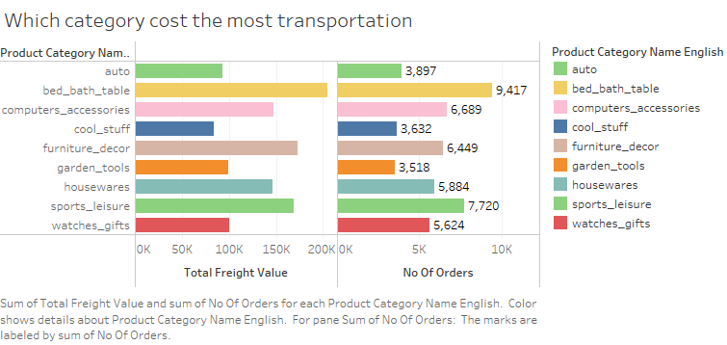

Slide 13
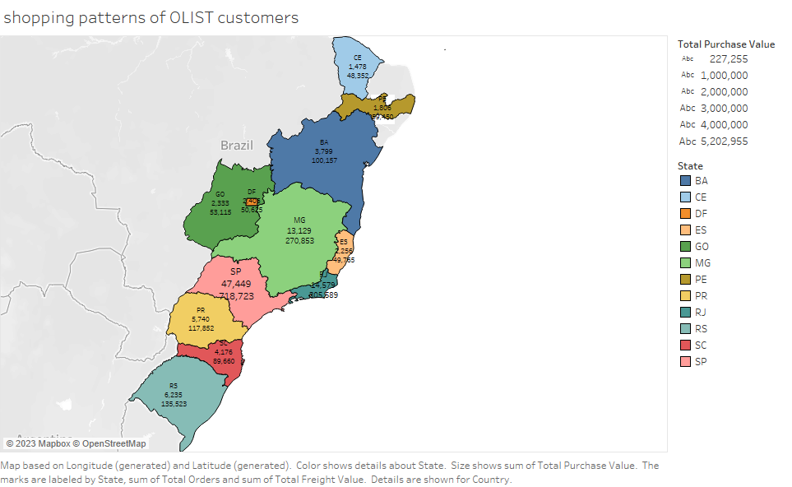
Show the shopping patterns of OLIST customers:
.

Slide 14
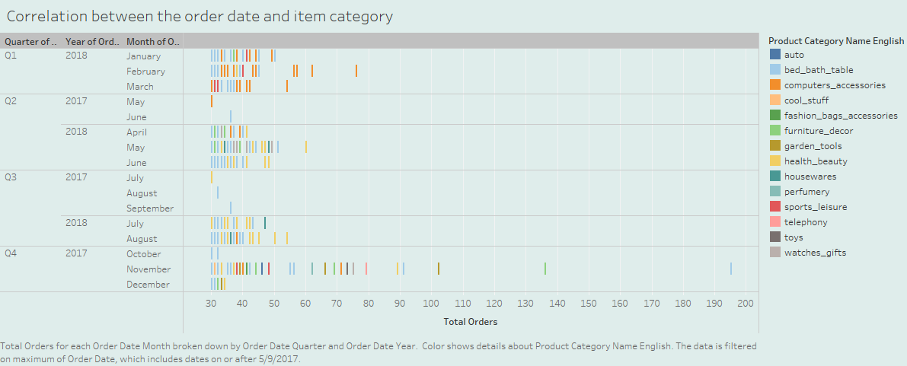
.

Slide 15
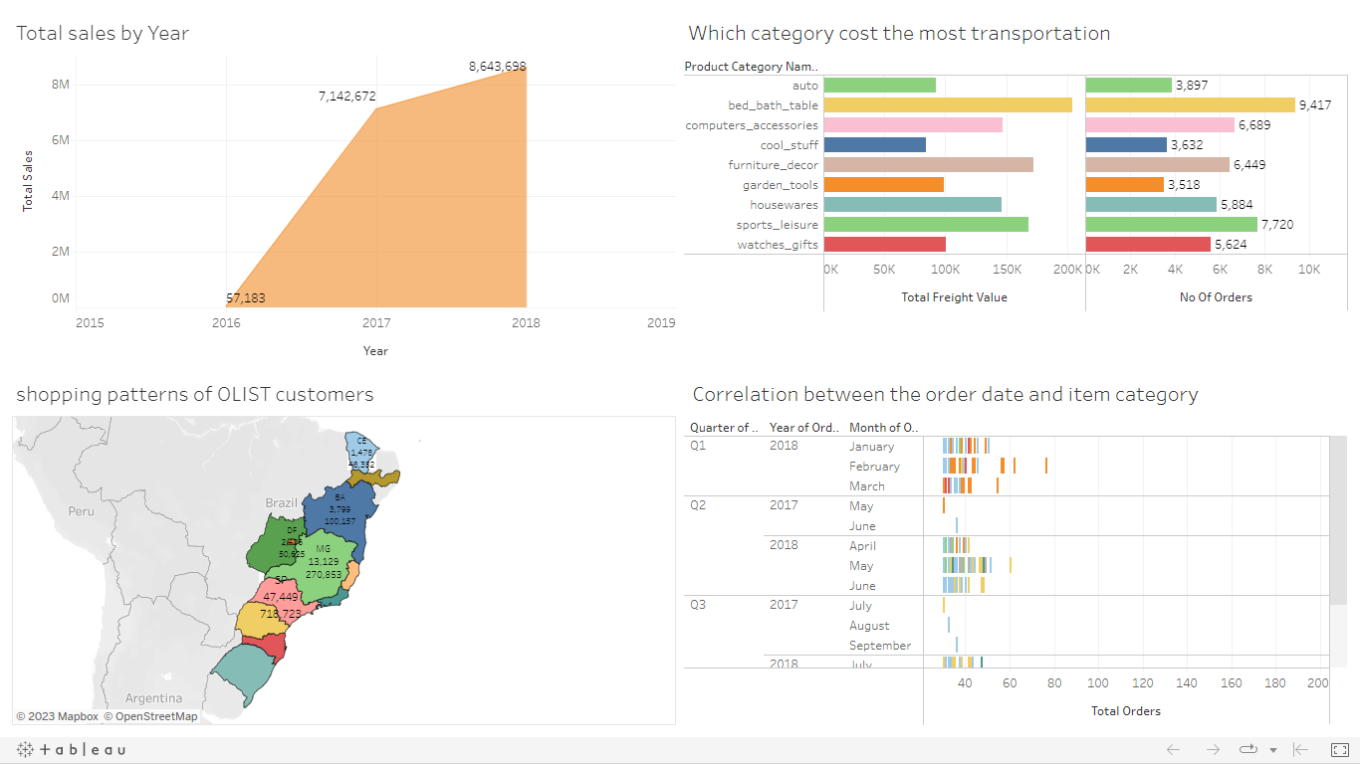
Dashboard:
.

Slide 16
Summary:
We cannot judge yearly sales and growth as this all months of 2016 and 2018 are not included. But there is exponential growth seen as per data given.
High Transportation cost Category Includes: bed_bath_table, health_beauty, furniture_decor, sports_leisure, computers_accessories, auto, garden tools, Housewares and watches_gifts.
High Logistic cost primarily due to larger size and high no. of orders.
Most orders are and revenue is generated from state of Sao Paulo.
More sales are in Q3 and Q4 and day vise on 24th November 2017 because of black Friday Sale.

Slide 17
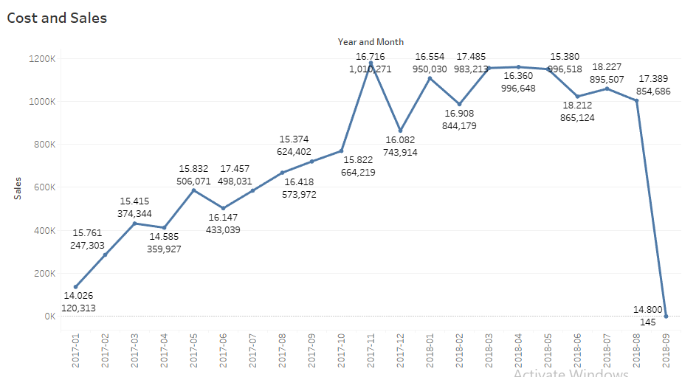
Cost of goods sold monthly for 2017 and 2018. In June 2018 has 18.212% highest sales percentage where total sales is 1,022,677 and total cost is 865,124.

Slide 18
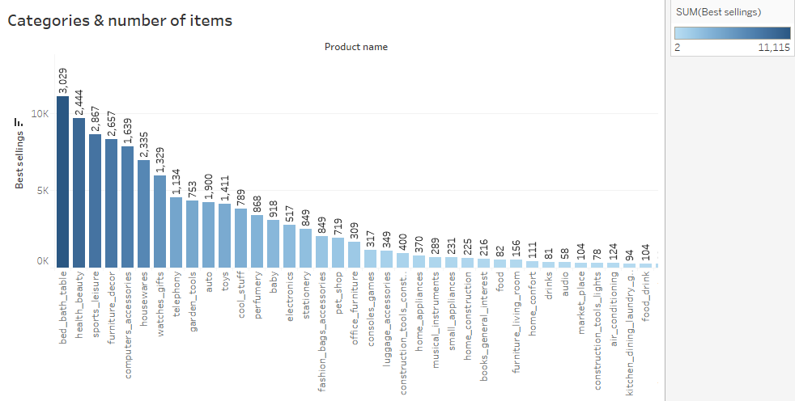
Show the number of categories present in the OLIST and how many items are present in that category. There are a total 71 categories and multiple items present in each category, also we make a correlation between number of items and number of items selling. Bed_bath_table have max 3029 items and cds_dvds_musicals have only min 1 item.

Slide 19
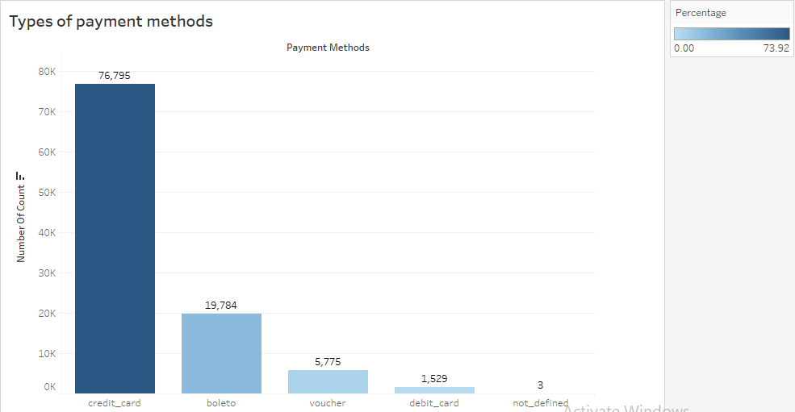
How many types of payment methods have been used for shopping and who has the highest percentage? Four different payment methods can be found: credit card, boleto, voucher and debit card. 3 payments had no payment defined against them. Credit cards have the highest 73.92% used for payments.

Slide 20
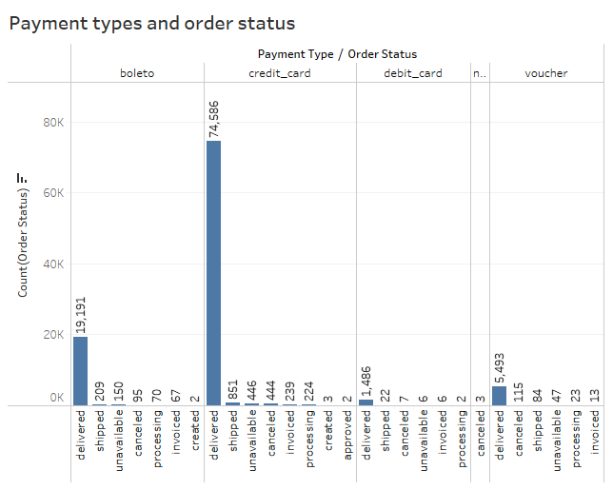
Find a correlation between payment method and order status:
We can find four payment methods: credit card, boleto, voucher and debit card and total eight order statuses. Here we analyze the correlation between payment method and order status: highest number of orders is 74586, placed by credit card payment method and the status is delivered.

Slide 21
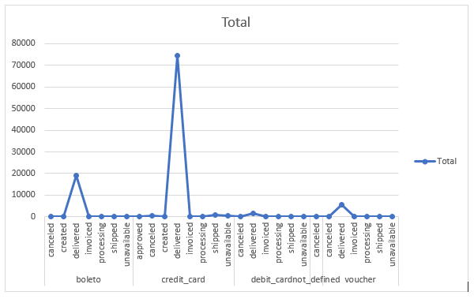
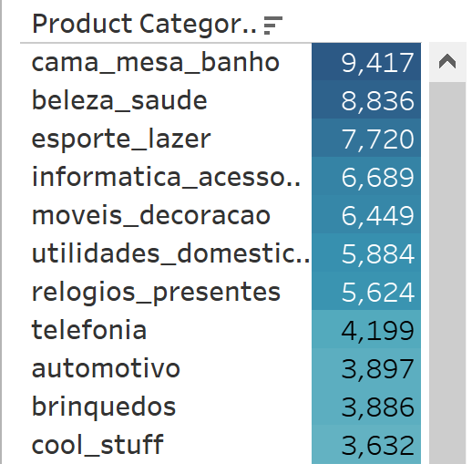
What is the best-selling category? Best-selling category: cama_mesa_banho
Visualize payment method and order status frequency.
.

Slide 22
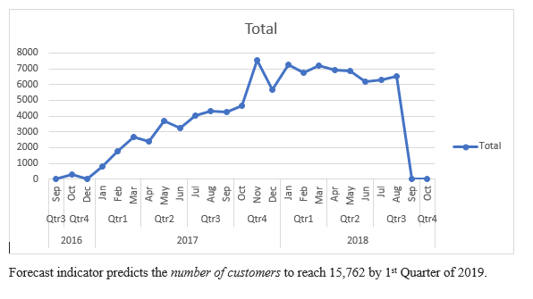
Can we predict the number of orders, item categories, or the number of customers/amounts in advance?
.

Slide 23
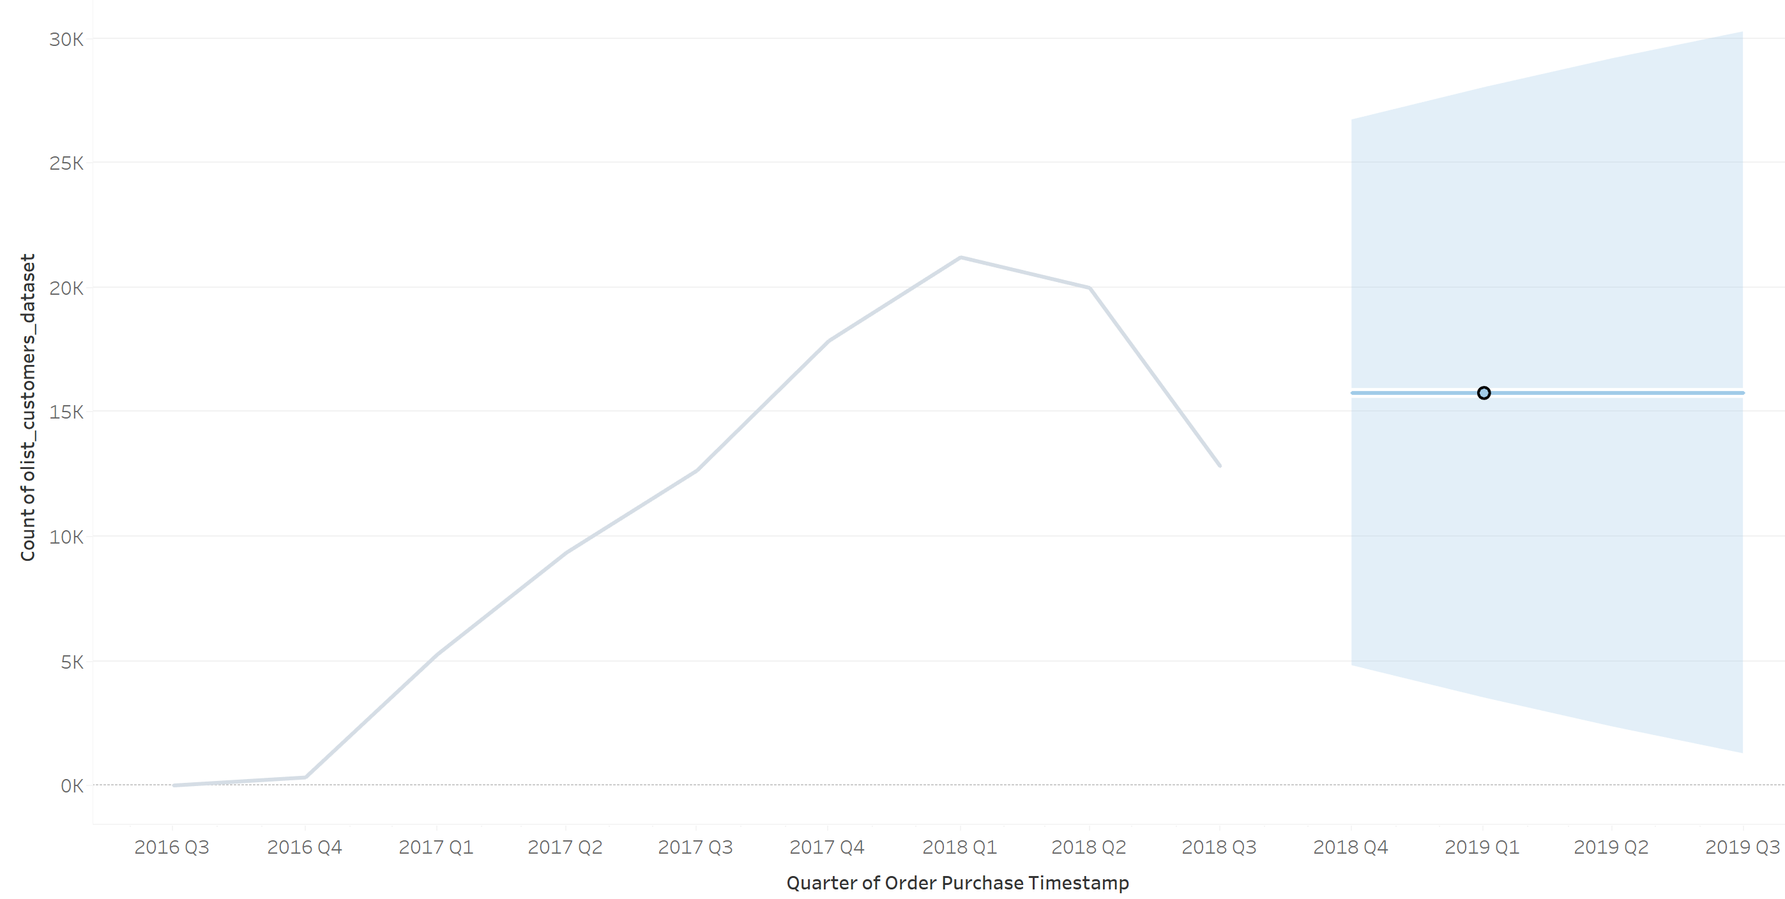
Can we predict the number of orders, item categories, or the number of customers/amounts in advance?
.

Slide 24
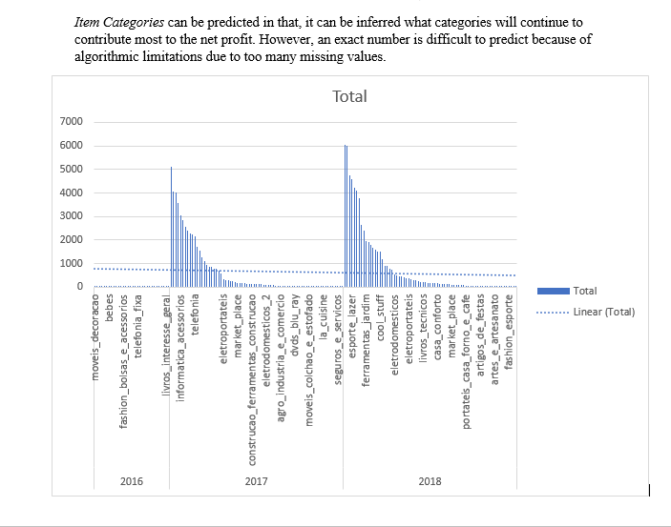
.

Slide 25
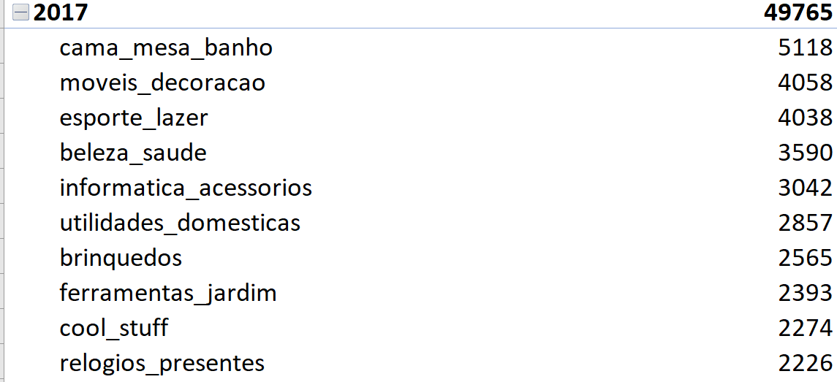
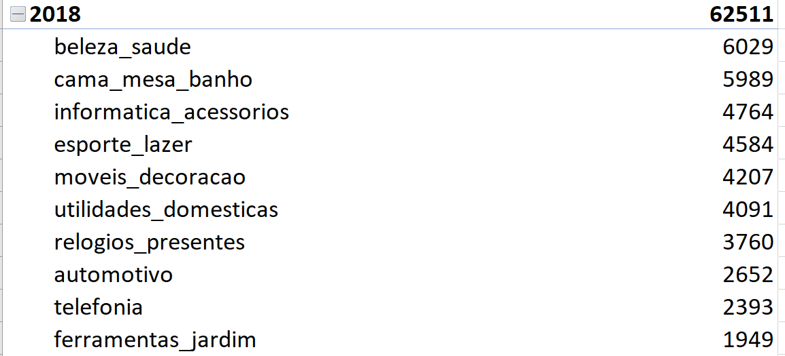
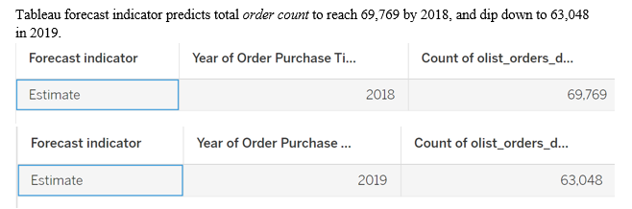
.

Slide 26
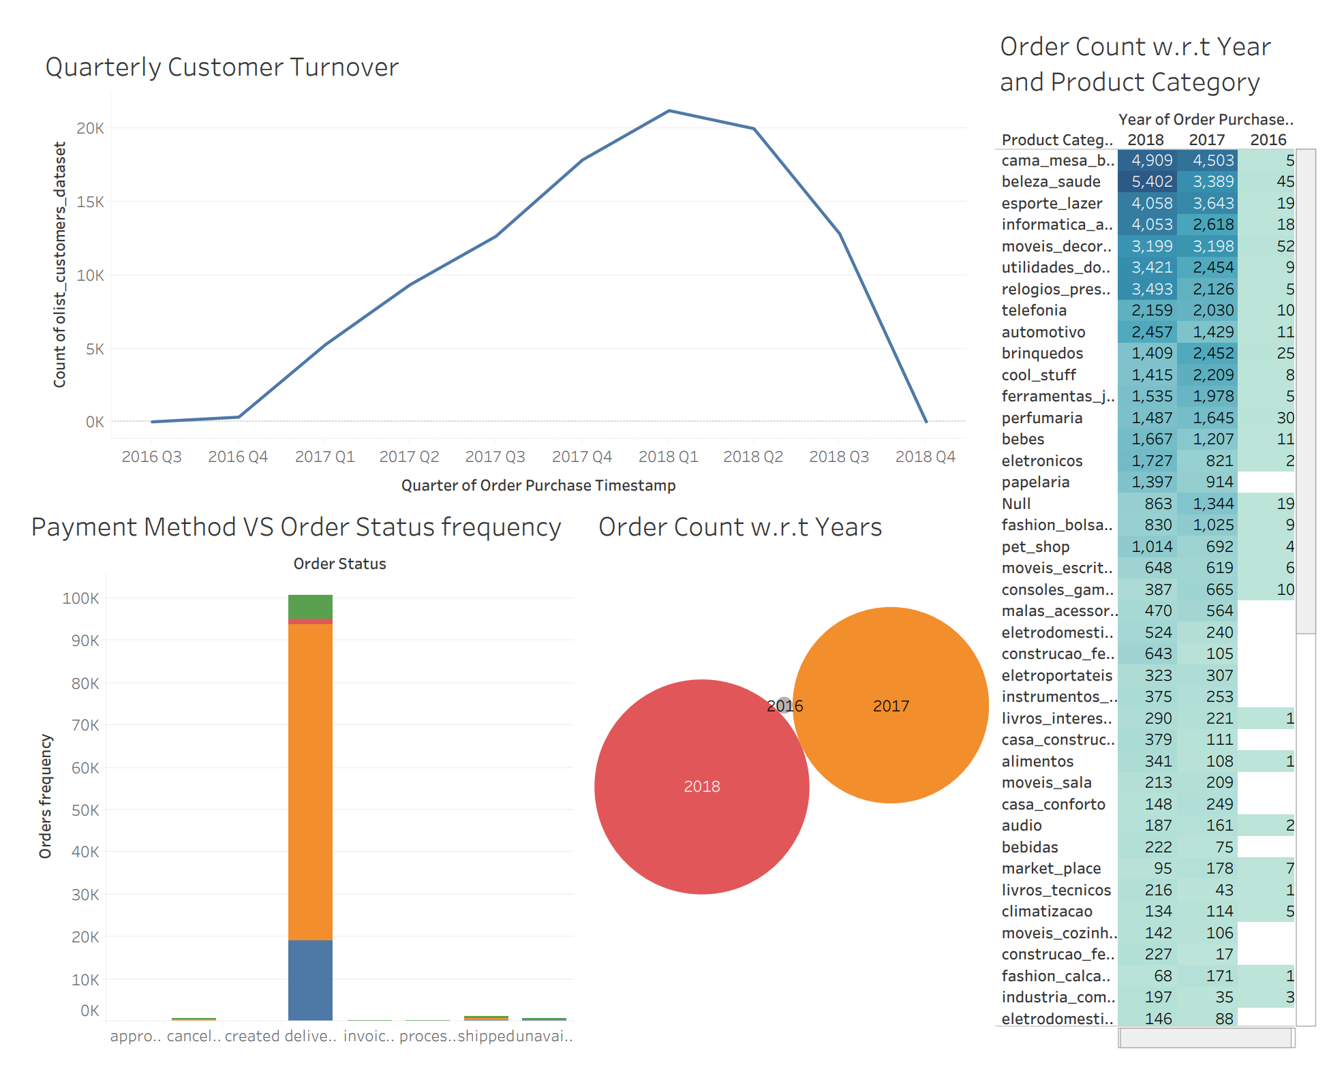
.

Slide 27
SUMMARY & RECOMMENDATIONS:
Low sales in states outside San Paulo:
Summary: There’s an indication that high freight values caused the gap in total transactions between Sao Paulo and other states to be very high.
Recommendation: Develop a new strategy to lower the freight cost for customers.
(2) Low Customer Retention rate:
Summary: New customers increase from 2017–2018 but the retention rate is very low.
Recommendation:
Customers need more attention to product recommendations and price incentives
Analyze customer leaving behavior.

Slide 28
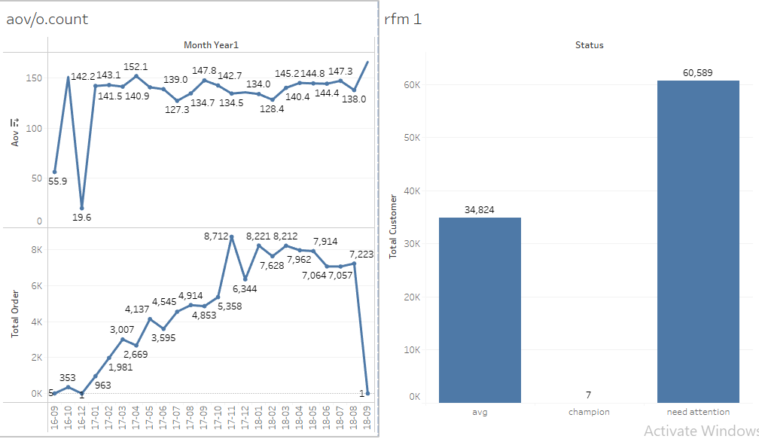
Dashboard:

Slide 29
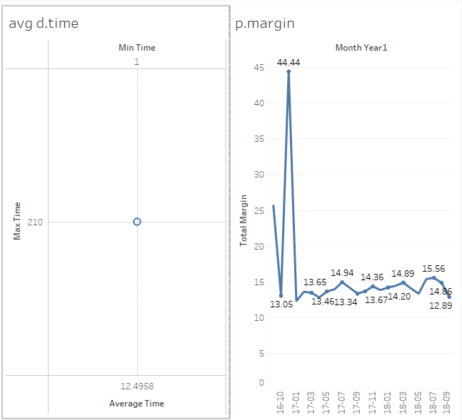

Slide 30
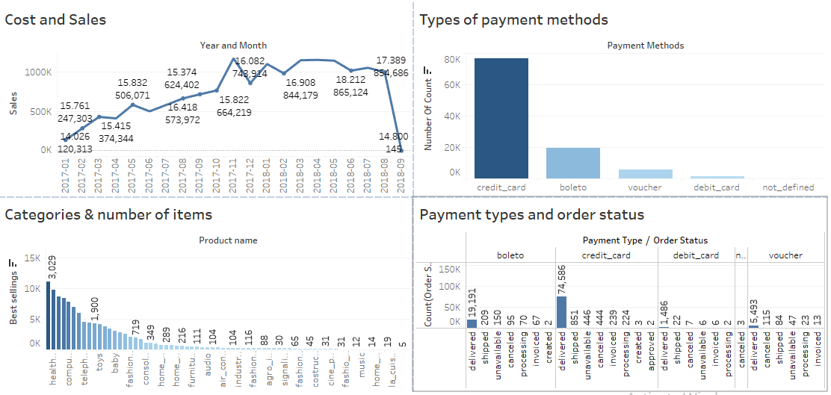
Dashboard:

Slide 31
Thank you!
Your Valuable Feedback

